Slide 1
Large Scale Machine Learning: Decision Trees
School of Computer Science and Engineering
Fairleigh Dickinson University – Vancouver
Ali Safari

Slide 2






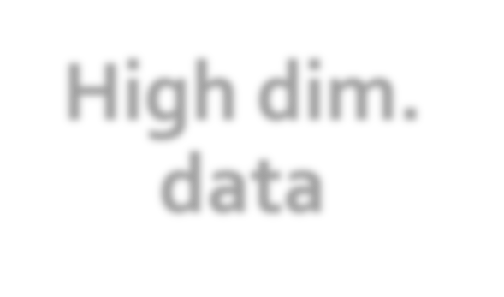

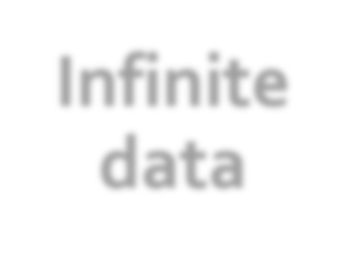














High dim. data
Graph data
Infinite data
Machine learning
Apps
Locality sensitive hashing
PageRank,
SimRank
Filtering data streams
Decision Trees
Recommen der systems
Community Detection
Web advertising
Random Forest, GBDT
Association Rules
Clustering
Dimensional ity reduction
Spam Detection
Queries on streams
Neural Networks, GNNs
Duplicate document detection

Slide 3

Supervised:
Given “labeled data” {𝑥, 𝑦}, learn 𝑓(𝑥) = 𝑦
Unsupervised:
Given only “unlabeled data” {𝑥}, learn 𝑓(𝑥)
Semi-supervised:
Given some labeled {𝑥, 𝑦} and some unlabeled data
{𝑥}, learn 𝑓(𝑥) = 𝑦
Active learning:
When we predict 𝑓 𝑥 = 𝑦, we then receive true y∗
Transfer learning:
Learn 𝑓(𝑥) so that it works well on new domain 𝑓(𝑧)

Slide 4

Given some data:
“Learn” a function to map from the
input to the output
Given:
Training examples 𝒙_{𝒊}, 𝒚_{𝒊} = 𝒇 𝒙_{𝒊}
unknown function 𝒇
Find:
A good approximation to 𝒇
for some

Slide 5
Would like to do prediction:
estimate a function 𝒇(𝒙) so that 𝒚 = 𝒇(𝒙)
Where y can be:
Real number: Regression
Categorical: Classification
Complex object:
Ranking of items, Parse tree, etc.
Data is labeled:
Have many pairs {(𝒙, 𝒚)}
x … vector of binary, categorical, real valued features
y … class label, or a real number

Slide 6
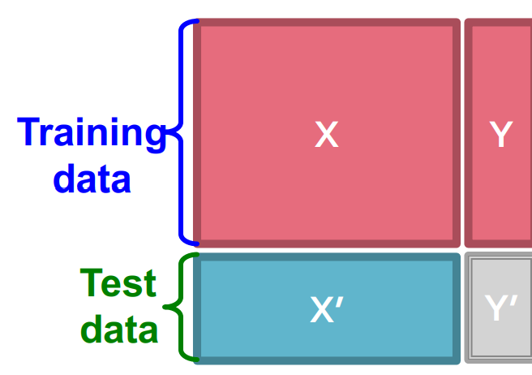
Task: Given data (𝑿, 𝒀) build a model 𝒇() to
predict 𝒀’ based on 𝑿’
Strategy: Estimate 𝒚 = 𝒇 𝒙
on (𝑿, 𝒀)
Hope that the same 𝒇(𝒙) also works to predict unknown 𝒀’
The “hope” is called generalization
Overfitting: If 𝒇(𝒙) predicts well 𝒀 but unable to predict 𝒀’
We want to build a model that generalizes well to unseen data

Slide 7

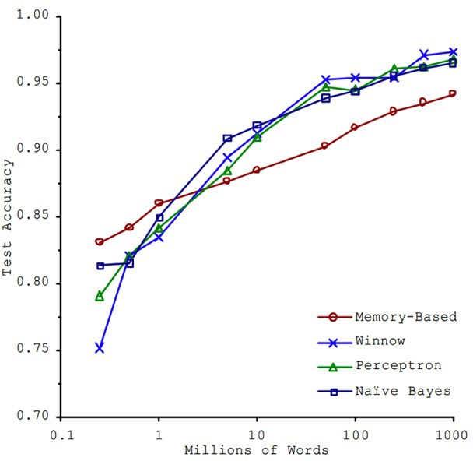
Brawn or Brains?
In 2001, Microsoft researchers ran a test to evaluate 4 of different approaches to ML-based language translation
Findings:
Size of the dataset used to train the model mattered more than the model itself
As the dataset grew large, performance difference between the models became small
Banko, M. and Brill, E. (2001) , “Scaling to Very Very Large Corpora for Natural Language Disambiguation”

Slide 8
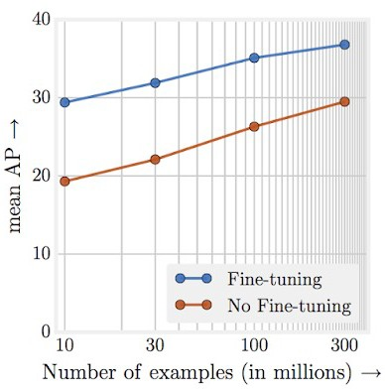
The Unreasonable Effectiveness of Data
In 2017, Google revisited the same type of experiment with the latest Deep Learning models in computer vision
Findings:
Performance increases logarithmically
based on volume of training data
Complexity of modern ML models (i.e., deep neural nets) allows for even further performance gains
Large datasets + large ML models => amazing results!!
“Revisiting Unreasonable Effectiveness of Data in Deep Learning Era”: https://arxiv.org/abs/1707.02968

Slide 9
A few reasons why this is important:
Classical tasks in NLP and Vision are getting commoditized (you take pretrained model and fine tune it), but there are many other unique ML tasks.
Deep models are often hard to scale and require lots and lots of data. Traditional models allow you to encode prior knowledge better and give you more control.
Personally, if I am working on a well understood problem I’d use deep learning, but if I am the first person to work on a new problem/classifier
I’d use techniques we’ll discuss here.

Slide 10

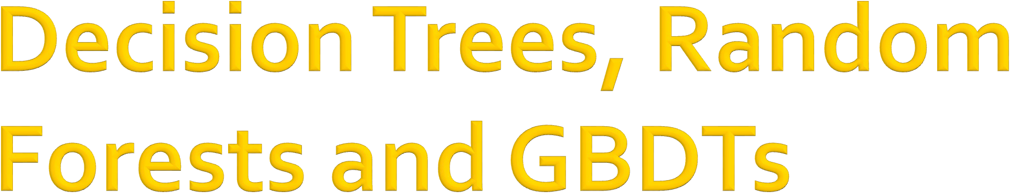

Slide 11
Decision trees are part of ML since 1980s
Introduced by Leo Breiman in 1984
Notable algorithms: ID3, C4.5
More recent innovations include:
Boosted decision trees (gradient boosted DT)
Random forest
Even though DTs are old, hand-engineered and heuristic, they are a method of choice for
tabular data and for Kaggle competitions.

Slide 12

Given one target attribute (e.g., lifespan), try to predict the value of new people’s lifespans by means of some of the other available attribute
Input attributes:
d features/attributes: 𝒙^{(𝟏)}, 𝒙^{(𝟐)}, … 𝒙^{(𝒅)}
Each 𝒙^{(𝒋)} has domain 𝑶_{𝒋}
Categorical: 𝑶_{𝒋} = {𝑚𝑎𝑙𝑒, 𝑓𝑒𝑚𝑎𝑙𝑒}
Numerical: 𝑯_{𝒋} = (1, 200)
𝒀 is output variable with domain 𝑶_{𝒀}:
Categorical: Classification e.g. Y = eye color
Numerical: Regression e.g. Y = lifespan
Data D:
𝒏 examples (𝒙_{𝒊}, 𝒚_{𝒊}) where 𝒙_{𝒊} is a 𝒅-dim feature vector,
𝒚_{𝒊} ∈ 𝑶_{𝒀} is output variable
Task:
Given an input data vector 𝒙 predict output label 𝒚

Slide 13











A Decision Tree is a tree-structured plan of a set of attributes to test in order to predict the output
A
yes
no
_{X}(1)_{<v}(1)
Y= 0.42
C
_{X}(2)_{∈{v}(2)_{, v}(3)}
D
F
F
G
H
I

Slide 14
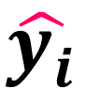
Input: Example 𝒙_{𝒊}
Output: Predicted “Drop” 𝒙_{𝒊} down the tree until it hits a leaf node
Predict the value stored in the leaf that 𝒙_{𝒊} hits
A
yes
no
_{X}(1)_{<v}(1)
Y= 0.42
C
_{X}(2)_{<v}(2)
D
F
_{X}(3)_{<v}(4)
_{X}(2)_{<v}(5)
F
G
H
I

Slide 15
Decision trees:
Split the data at each internal node
Each leaf node makes a prediction
Lecture today:
Binary splits: 𝑿^{(𝒋)} < 𝒗
Numerical attributes
Regression
A
yes
no
_{X}(1)_{<v}(1)
Y= 0.42
C
_{X}(2)_{<v}(2)
D
F
_{X}(3)_{<v}(4)
_{X}(2)_{<v}(5)
F
G
H
I

Slide 16
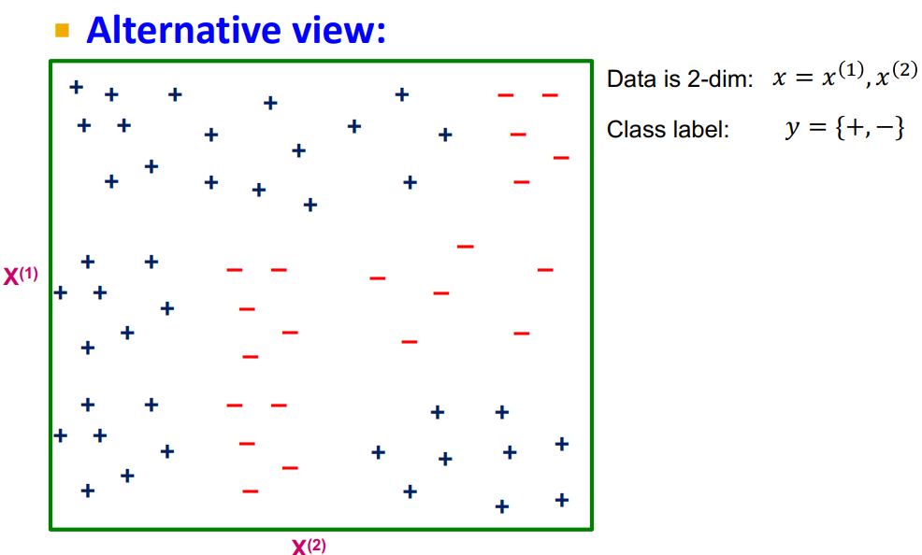

Slide 17












Alternative view:
_{V}(3)
_{X}(1)
+ ₊ + + ₊ + |  |  | + | + + | + | + | + |  | + |  | – –
 |  |  |  |  |  |  |  |  |  |  | –
 |  |  |  |  |  |  |  |  |  |  | –
 |  |  |  | + ₊ | + |  | +
 |  |  |  |  |  |  |  |  |  |  | –
+ + + + ₊ |  |  |  | – – – – – – – – – – |  |  | – |  | – | – | –
+ | + |  |  |  |  |  | – |  |  |  | –
+ |  | + |  |  |  |  |  |  | + |  | + ₊ + ₊ +
+ + ₊
 |  |  |  |  |  |  | + |  | +
+ | +
 |  |  |  |  |  |  |  | +
A
_{X}(1)_{<v}(1)
_{X}(2)_{<v}(2)
C
_{X}(2)_{<v}(3)
F
_{V}(1)
Y=
+
D
_{X}(2)_{<v}(4)
Y=
+
Y=
–
Y=
H
_{X}(1)_{<v}(5)
Y=
–
_{V}(5)
Y=
+
–
_{X(2)}
_{V}(2)
_{V}(4)

Slide 18



Training dataset 𝑫∗, |𝑫∗| = 𝟏𝟎𝟎 examples
# of examples
A
traversing the edge
|D|=10
|D|=90
_{X}(1)_{<v}(1)
|D|=45
B
Y=0.42
C
|D|=45
_{X}(2)_{<v}(2)
D
E
|D|=20
|D|=25
|D|=15
_{X}(2)_{<v}(5)
H
|D|=30
_{X}(3)_{<v}(4)
F
G
I

Slide 19






















Imagine we are currently at some node G
Let D_{G} be the data that reaches G
There is a decision we have to make: Do we continue
building the tree?
A
B
C
D
E
F
G
H
I
If yes, which variable and which value do we use for a split?
Continue building the tree recursively
If not, how do we make a prediction?
We need to build a “predictor node”

Slide 20
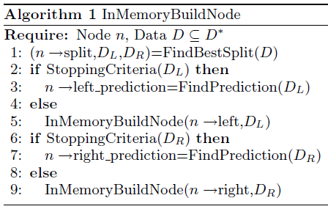
BuildSubtree
(1)
(2)
(3)
BuildSubtree
BuildSubtree
Requires at least a single pass over the data!

Slide 21


















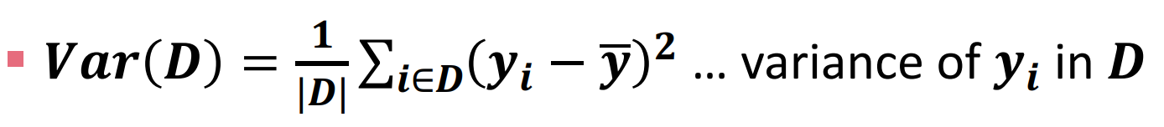
(1) How to split? Pick attribute & value that optimizes some criterion
A
|D|=10
|D|=90
_{X}(1)_{<v}(1)
.42
C
|D|=45
_{X}(2)_{<v}(2)
|D|=45
D
E
Regression: Purity
Find split (𝑿^{(𝒊)}, 𝒗) that creates 𝑫, 𝑫_{𝑳}, 𝑫_{𝑹}: parent, left, right child datasets and maximizes:
|D|=20
|D|=25
|D|=15
|D|=30
_{X}(3)_{<v}(4)
_{X}(2)_{<v}(5)
F
G
H
I
𝑫 ⋅ 𝑽𝒂𝒓 𝑫 − 𝑫_{𝑳} ⋅ 𝑽𝒂𝒓 𝑫_{𝑳} + 𝑫_{𝑹} ⋅ 𝑽𝒂𝒓 𝑫_{𝑹}

Slide 22


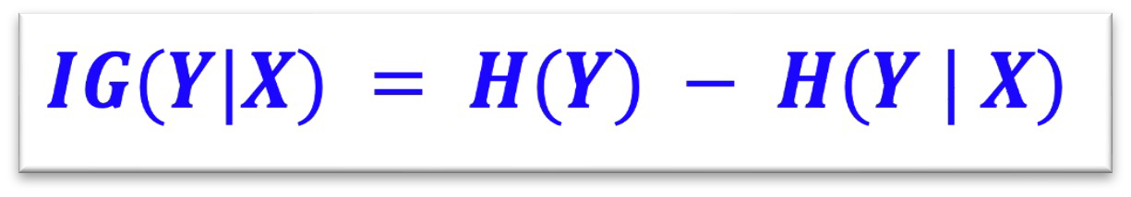
(1) How to split? Pick attribute & value that optimizes some criterion
A
|D|=10
|D|=90
_{X}(1)_{<v}(1)
.42
C
|D|=45
_{X}(2)_{<v}(2)
|D|=45
D
E
Classification: Information Gain
|D|=20
|D|=25
|D|=15
|D|=30
_{X}(3)_{<v}(4)
_{X}(2)_{<v}(5)
F
G
H
I
Measures how much
a given attribute 𝑿 tells us about the class 𝒀
𝑰𝑮(𝒀 | 𝑿) : We must transmit 𝒀 over a binary link. How many bits on average would it save us if both ends of the line knew 𝑿?

Slide 23
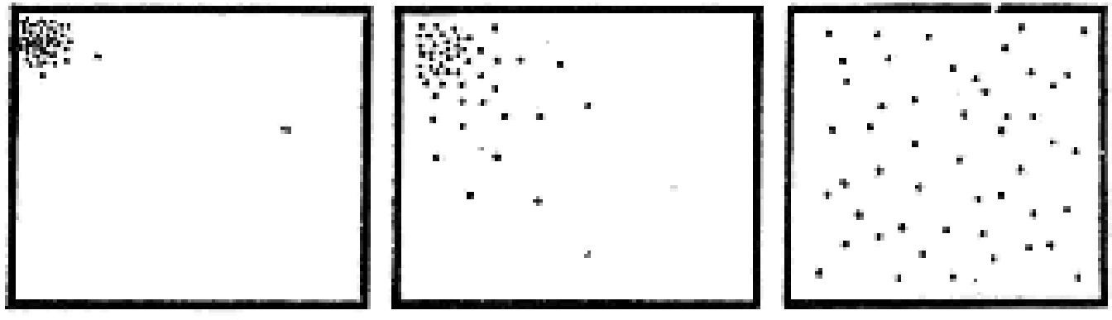
Entropy:
Consider random variable 𝑿 = 𝑿_{𝟏}, … , 𝑿_{𝐦} What’s the smallest possible number of bits, on average, per symbol, that we need to transmit a
stream of symbols drawn from 𝑿’s distribution?
The entropy of 𝑿: 𝑯 𝑿 = − ∑^{𝒎} 𝒑(𝑿_{𝒋}) 𝒍𝒐𝒈 𝒑(𝑿_{𝒋})
𝒋=𝟏
“High Entropy”: 𝑿 is from a uniform (boring) distribution
A histogram of the frequency distribution of values of 𝑿 is flat
“Low Entropy”: 𝑿 is from a varied (peaks/valleys) distrib.
A histogram of the frequency distribution of values of 𝑿 would have many lows and one or two highs
Low entropy
High entropy

Slide 24
Suppose I want to predict 𝒀 and I have input 𝑿
𝑿 = College Major
𝒀 = Likes “Casablanca”
From this data we estimate
𝑃(𝑌 = 𝑌𝑒𝑠) = 0.5, P(Y=No)=0.5
𝐻(𝑌) = −½log₂(½) − ½log₂(½) = 𝟏
𝑃(𝑋 = 𝐶𝑆) = 0.25
𝑃(𝑋 = 𝐻𝑖𝑠𝑡𝑜𝑟𝑦) = 0.25
𝑃(𝑋 = 𝑀𝑎𝑡ℎ) = 0.5
X | Y
Math | Yes
History | No
CS | Yes
Math | No
Math | No
CS | Yes
Math | Yes
History | No
=1.5
Base 2

Slide 25
Suppose I want to predict 𝒀 and I have input 𝑿
𝑿 = College Major
𝒀 = Likes “Casablanca”
Def: Specific Conditional Entropy
𝑯(𝒀 | 𝑿 = 𝒗) = The entropy of 𝒀 among only those records in which 𝑿 has value 𝒗
Example:
𝐻(𝑌|𝑋 = 𝑀𝑎𝑡ℎ) = 1
𝐻(𝑌|𝑋 = 𝐻𝑖𝑠𝑡𝑜𝑟𝑦) = 0
𝐻(𝑌|𝑋 = 𝐶𝑆) = 0
X | Y
Math | Yes
History | No
CS | Yes
Math | No
Math | No
CS | Yes
Math | Yes
History | No

Slide 26
Suppose I want to predict 𝒀 and I have input 𝑿
𝑿 = College Major
𝒀 = Likes “Casablanca”
Def: Conditional Entropy
𝑯(𝒀 | 𝑿) = The average specific conditional entropy of 𝒀
if you choose a record at random what will be the conditional entropy of 𝒀, conditioned on that row’s value of 𝑿
Expected number of bits to transmit 𝒀
if both sides knew the value of 𝑿
= ∑_{𝒋} 𝑷 𝑿 = 𝒗_{𝒋} 𝑯(𝒀|𝑿 = 𝒗_{𝒋})
X | Y
Math | Yes
History | No
CS | Yes
Math | No
Math | No
CS | Yes
Math | Yes
History | No

Slide 27
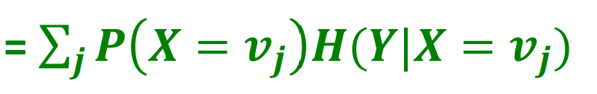
Suppose I want to predict 𝒀 and I have input 𝑿
𝑯(𝒀 | 𝑿) = The average specific conditional entropy of 𝒀
X | Y
Math | Yes
History | No
CS | Yes
Math | No
Math | No
CS | Yes
Math | Yes
History | No
V_{j} | P(X=v_{j}) | H(Y|X=v_{j})
Math | 0.5 | 1
History | 0.25 | 0
CS | 0.25 | 0
So: H(Y|X)=0.5*1+0.25*0+0.25*0 = 0.5

Slide 28
Suppose I want to predict 𝒀 and I have input 𝑿
Def: Information Gain
𝑰𝑮(𝒀|𝑿) = I must transmit 𝒀. How many bits on average would it save me if both ends of the line knew X?
𝑰𝑮(𝒀|𝑿) = 𝑯(𝒀) − 𝑯(𝒀 | 𝑿)
Example:
H(Y) = 1
H(Y|X) = 0.5
Thus IG(Y|X) = 1 – 0.5 = 0.5
X | Y
Math | Yes
History | No
CS | Yes
Math | No
Math | No
CS | Yes
Math | Yes
History | No
28

Slide 29
Suppose you are trying to predict whether someone is going to live past 80 years
From historical data you might find:
𝑰𝑮(𝑳𝒐𝒏𝒈𝑳𝒊𝒇𝒆 | 𝑯𝒂𝒊𝒓𝑪𝒐𝒍𝒐𝒓) = 𝟎. 𝟎𝟏
𝑰𝑮(𝑳𝒐𝒏𝒈𝑳𝒊𝒇𝒆 | 𝑺𝒎𝒐𝒌𝒆𝒓) = 𝟎. 𝟒
𝑰𝑮(𝑳𝒐𝒏𝒈𝑳𝒊𝒇𝒆 | 𝑮𝒆𝒏𝒅𝒆𝒓) = 𝟎. 𝟐𝟓
𝑰𝑮(𝑳𝒐𝒏𝒈𝑳𝒊𝒇𝒆 | 𝑳𝒂𝒔𝒕𝑫𝒊𝒈𝒊𝒕𝑶𝒇𝑺𝑺𝑵) = 𝟎. 𝟎𝟎𝟎𝟎𝟏
IG tells us how much information about 𝒀 is contained in 𝑿
So attribute X that has high 𝑰𝑮(𝒀|𝑿) is a good split!

Slide 30
BuildSubtree
(1)
(2)
(3)
BuildSubtree
BuildSubtree

Slide 31

(2) When to stop?
A
|D|=10
|D|=90
_{X}(1)_{<v}(1)
Many different heuristic options
Two ideas:
(1) When the leaf is “pure”
The target variable does not vary too much: 𝑽𝒂𝒓(𝒚) < ε
(2) When # of examples in the leaf is too small
For example, |𝑫|<= 𝟏𝟎𝟎
.42
C
|D|=45
_{X}(2)_{<v}(2)
|D|=45
D
E
|D|=20
|D|=25
|D|=15
|D|=30
_{X}(3)_{<v}(4)
_{X}(2)_{<v}(5)
F
G
H
I

Slide 32

(3) How to predict?
A
|D|=10
|D|=90
Many options
Regression:
Predict average 𝒚_{𝒊} of the examples in the leaf
Build a linear regression model on the examples in the leaf
Classification:
Predict most common 𝒚_{𝒊} of the examples in the leaf
_{X}(1)_{<v}(1)
.42
C
|D|=45
_{X}(2)_{<v}(2)
|D|=45
D
E
|D|=20
|D|=25
|D|=15
|D|=30
_{X}(3)_{<v}(4)
_{X}(2)_{<v}(5)
F
G
H
I

Slide 33
Characteristics
Classification & Regression
Multiple (~10) classes
Real valued and categorical features
Few (hundreds) of features
Usually dense features
Complicated decision boundaries
Early stopping to avoid overfitting!
Example applications
User profile classification
Landing page bounce prediction

Slide 34
Decision trees are the single most popular data mining tool:
Easy to understand
Easy to implement
Easy to use
Computationally cheap
It’s possible to mitigate overfitting (i.e., with ensemble methods)
They do classification as well as regression!

Slide 35
Problem: Many times we want to predict association between a user 𝑢 and an item 𝑥
For example, how likely user 𝑢 is to interact with item 𝑥, e.g. how likely is she/he to click on a specific ad
Issue: Many sparse features:
User: Demographics, interests, prior activity, …
Ad: Keywords, topic, provider, …
Goal: Build 𝑓(𝑢, 𝑥)
Notice:
Linear model that concatenates features (𝑤 ⋅ [𝑢, 𝑥]) is not able to learn that women like healthy food ads.
We need to “cross” features: 𝑢×𝑥
Create new feature: (gender, ad topic),
E.g. (man, healthy food), (woman, healthy food)
Issue: Number of features explodes!

Slide 36












Solution: Build Feature Transforms using decision trees:
Decision tree picks the best cross-features
Gender
F
M
G
T
T
Ad topic
Healthy
Healthy
(Female, Healthy) is encoded as:
0 0 1 0
Drop the example into the tree and use 1-hot encoding to denote the leaf it ends at.
“gender-adTopic” is a new feature; it takes 4 values
Use these 1-hot vectors as inputs to a linear classifier

Slide 37
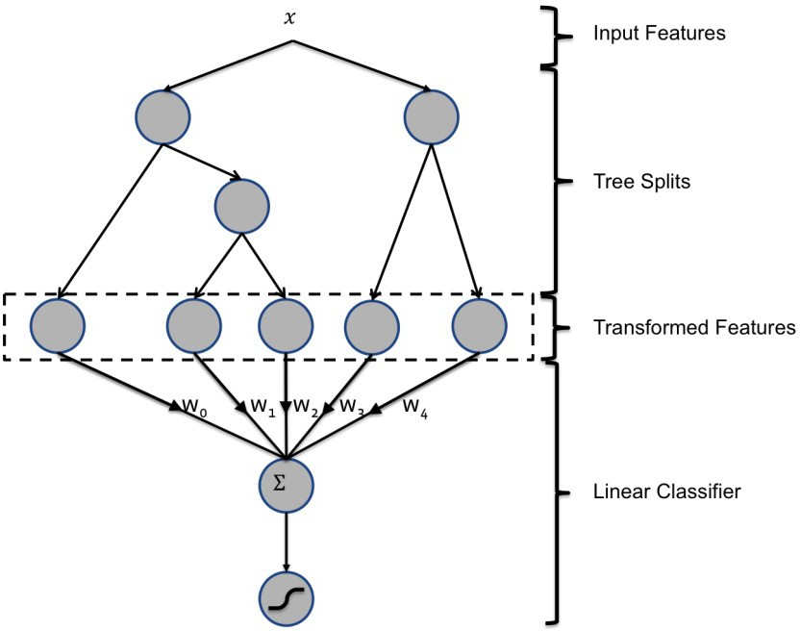
Overall architecture:

Slide 38
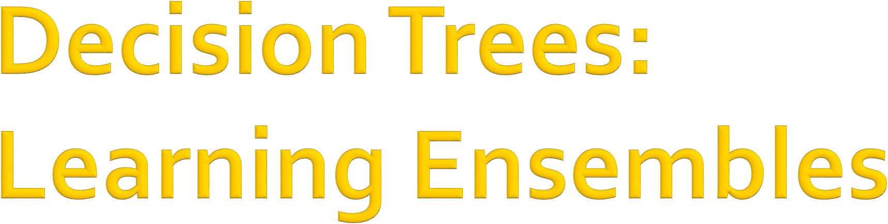

Slide 39
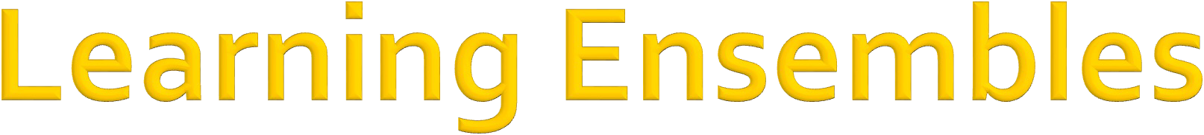
Learn multiple trees and combine their predictions
The “wisdom of crowds”
A group/ ensemble of base learners that collectively achieve a better final prediction.
Decision trees are prone to
Overfitting (high variance and low bias) when it hasn’t been pruned
Underfitting (low variance and high bias) when it’s very small, i.e. a decision stump.
Ensemble reduces bias or variance, yielding better model performance.

Slide 40
There are two main types of ensemble learning:
Bagging and Boosting
Bagging (bootstrap aggregation):
Learns multiple trees in parallel over independent samples of the training data
1) Bootstrapping: Given a dataset, create multiple datasets by sampling data points randomly and with replacement.
2) Parallel training: Train decision trees on samples independently and in parallel with each other
3) Aggregation: Depending on the task (i.e. regression or classification), an average or a majority of the predictions are computed for a more accurate estimate.
Regression, an average is taken of all the outputs predicted by the individual classifiers; this is known as “soft voting”.
Classification, the class with the highest majority of votes is accepted; this is “hard voting” or majority voting.

Slide 41
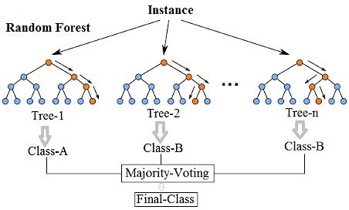

Slide 42
So far we did instance bagging.
Decision trees are greedy
They choose which variable to split on using a greedy algorithm that minimizes error.
Even with Bagging, the decision trees can have a lot of structural similarities and in turn have high correlation in their predictions.
Feature Bagging
Pick a random sample of features at each split
less correlation among trees
Random forest

Slide 43
Train a Bagged Decision Tree
But use a modified tree learning algorithm that selects (at each candidate split) a random subset of features
If we have 𝑑 features, consider 𝑑 random features
This is called: Feature bagging
Benefit: Breaks correlation between trees
If one feature is very strong predictor, then every tree will select it, causing trees to be correlated.
Random Forests achieve state-of-the-art results in many classification problems!

Slide 44
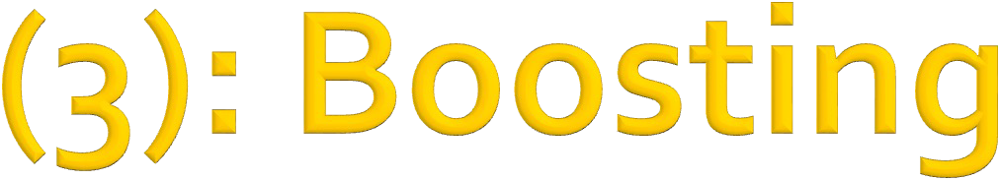
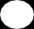
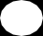
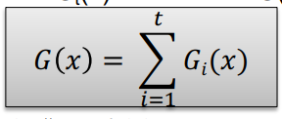
Boosting: Another ensemble learning algorithm
Combines the outputs of many “weak” classifiers to produce a powerful “committee”
Learns multiple trees sequentially, each trying to improve upon its predecessor
Final classifier is weighted sum of the individual classifiers
Data re- weighting based on residual
...
Final Model
Data
G₁(x)
G₂(x)
Residual: Difference between prediction and ground truth
G_{t}(x)
G(x)
x

Slide 45
We will show 2 algorithms:
Example 1: AdaBoost
Where each 𝐺(𝑥) is a one–level decision tree
Example 2: Gradient Boosted Decision Trees (GBDT)
Where each 𝐺 (𝑥) is a multi–level decision tree
Data re- weighting based on residual
...
Final Model
Data
G₁(x)
G₂(x)
Residual: difference between prediction and ground truth
G_{t}(x)
G(x)
x

Slide 46
AdaBoost

Slide 47

AdaBoost = Adaptive Boosting
It builds many weak learners and ensembles their predictions
The individual learners can be weak, but as
long as the performance of each one is slightly better than random guessing, the final model converge to a strong learner.
Every weak learner used in AdaBoost is tweaked in favor of instances misclassified by
previous weak learners.

Slide 48
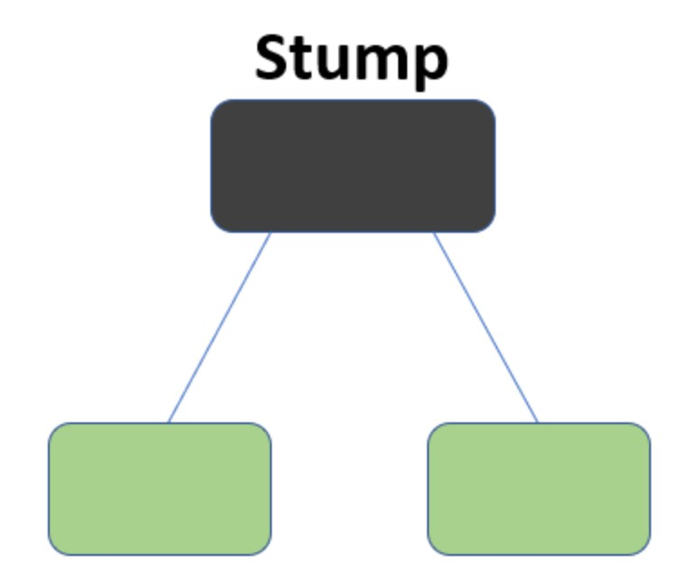
Decision “stumps”:
1-level decision tree
A decision boundary based on one feature
E.g.: If someone is not a smoker, then predict them to live past 80 years old
Building blocks of AdaBoost algorithm
Decision stump is a weak learner
+
+
+
Boosting theory:
if weak learners have
>50% accuracy then we can learn a perfect classifier.
–
–
+
–
A decision stump

Slide 49
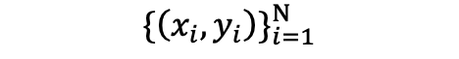
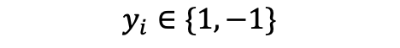
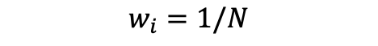
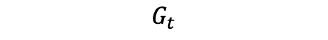
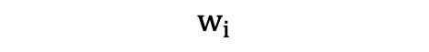
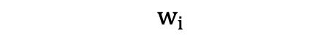
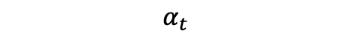
Suppose we have training data
,
Initialize equal weights for all observations
At each iteration t:
Train a stump using data weighted by
Compute the misclassification error adjusted by
Compute the weight of the current tree
Reweight each observation based on prediction accuracy

Slide 50
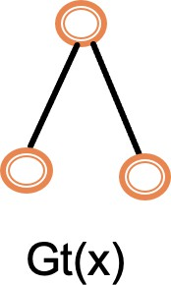
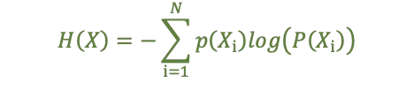
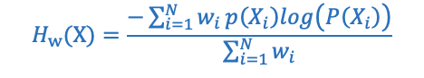
Step1- Train a stump. How to split?
Apply weighting to the splitting criterion function and optimize the function to find the best split
We'll use information gain as an example
Recall :
Information gain
where
After weighting:

Slide 51





Step2- Calculate the weighted misclassification error
Step3- Weight the current tree in the final classifier:
𝑦 = log(^{1 − 𝑥})
𝑥
A classifier with 50% accuracy is given a weight of zero;
Step4- Use misclassification error and tree weight to reweight the training data:
Harder to classify training instances get higher weight

Slide 52


Final prediction is a weighted sum of the predictions from each stump:
More accurate trees are weighted higher in the final model

Slide 53


Train a stump
Compute error
Compute tree weight
Reweight data

Slide 54
Iteratively train weak learners (decision stumps) to form a strong model:
Trees with high accuracy are given more weights in the final model
Misclassified data get higher weights in the next iteration
AdaBoost is the equivalent to additive training with the exponential loss (Friedman et al. 2000)
We will talk about additive training in more general scenarios next!

Slide 55


Slide 56


Idea: Additive training
Start with a constant prediction, add a new decision tree each time. It can be multi-level!
Let’s see it in an example for regression.
drug dosage (x) | drug effectiveness (y)
10 | -10
20 | 7
25 | 8
35 | -7
Since problem is regression, the loss function is

Slide 57





Start with a constant prediction:
Compute residuals = observed – predicted
Build next tree by putting All residuals into a leaf
residuals
Compute similarity score
𝜆 is a regularization hyperparameter

Slide 58

Let’s set 𝜆 = 0

Slide 59

Let’s set 𝜆 = 0
Let’s grow the tree:
Dosage < 15

Slide 60

Let’s set 𝜆 = 0
Let’s grow the tree:
Dosage < 15

Slide 61



Let’s set 𝜆 = 0
Let’s grow the tree:
Dosage < 22.5
Similarity = 4
Similarity = 8
Similarity = 0

Slide 62






Let’s set 𝜆 = 0
Let’s grow the tree:
Dosage < 30
Similarity = 4
Similarity = 4.08
Similarity = 56.25

Slide 63






So far:
Dosage < 22.5
Similarity = 42.25
Similarity = 0

Slide 64

So far:
Dosage < 30
Similarity = 98
Similarity = 56.25

Slide 65

So far we have:
Let’s assume we are done growing this tree!

Slide 66

So far we have:
output = -10.5
To make predictions:
output = 7
output =-7.5
Compute an output value for each leaf

Slide 67
So far we have:
output = -10.5
output = 7
output =-7.5
New prediction=0.5 + 0.3 x(-10.5)=-2.65

Slide 68
So far we have:
output = -10.5
output = 7
output =-7.5
New prediction=0.5 + 0.3 x7=2.6

Slide 69


To build the next tree:
Compute residuals
Put all residuals into a leaf
-7.35, 4.4, 5.4, -5.25
Compute its similarity score and split.....

Slide 70

XGBoost: A Scalable Tree Boosting System, T. Chen etal, KDD2016
Now let’s look at the math
Prediction at training round t
Keep predictions from previous rounds
New model

Slide 71

77

Slide 72


Slide 73


































The approximate objective:
Define model complexity of tree f as
A
B
C
D
E
T… number of leaves of tree 𝑓
𝛾… cost adding a leaf to the tree 𝑓
𝒘_{𝒋} is output value of j-th leaf

Slide 74



So our objective is:
We can re-write it by leaf
𝐼_{𝑗} contains index of data points that are in leaf j
q(x) denotes the leaf that data point x belongs to
Associated with leaf node 𝑗
Notice this is a sum of 𝑇 quadratic functions, each function is associated with a leaf node 𝑗

Slide 75







Each quadratic function associated with leaf j:
The minimizer is:
𝐺_{𝑗}
𝑤∗ = −
:
𝐻_{𝑗} + 𝜆
The minimum value of objective is:
F
_{𝐺}D
The Obj function measures the quality of the set of T trees. This score is like the impurity score for evaluating decision trees, except that it is derived for a wider range of objective functions
1
𝑂𝑏𝑗 = − w
:
+ 𝛾𝑇
2 𝐻_{𝑗} + 𝜆
:;<

Slide 76


Derive 𝒈 and 𝒉 for square loss:
And
𝐺_{𝑗}
∑A∈H: ^{𝑔}𝑖
∑A∈H: ^{ℎ}𝑖 ^{+ 𝜆}
𝑤∗ = −
= −
:
𝐻_{𝑗} + 𝜆

Slide 77

Derive 𝒈 and 𝒉 for square loss:
And
:

Slide 78

Derive 𝒈 and 𝒉 for square loss:
And

Slide 79


Given a tree 𝒇_{𝒕}, we know how to
Calculate the score for 𝑓:
And then set optimal weights for the chosen 𝑓:
In principle we could:
Enumerate possible tree structures 𝑓 and take the one that minimizes 𝑂𝑏𝑗

Slide 80
In practice we grow tree greedily:
Start with tree with depth 0
For each leaf node in the tree, try to add a split
The change of the objective after adding a split is:
similarity score of left child
Similarity score of right child
Similarity score of parent
Take the split that gives best gain
Next: How to find the best split?

Slide 81
For each node, enumerate over all features
For each feature, sort the instances by feature value
Use a linear scan to decide the best split along that feature
Take the best split solution along all the features
Pre-stopping:
Stop split if the best split have negative gain
But maybe a split can benefit future splits..
Post-Prunning:
Grow a tree to maximum depth, recursively prune all the leaf splits with negative gain.

Slide 82


Add a new tree 𝒇_{𝒕}(𝒙) in each iteration
Compute necessary statistics for our objective
Greedily grow the tree that minimizes the objective:
Add 𝒇_{𝒕}(𝒙) to our ensemble model
𝜂 is called step-size or shrinkage, usually set around 0.1 to 0.3 to prevent overfitting
𝑦^{(&)} = 𝑦^{(&())} + 𝜂𝑓&(𝑥* )
Repeat until we use 𝑴 ensemble of trees

Slide 83

XGBoost: eXtreme Gradient Boosting
A highly scalable implementation of gradient boosted decision trees with regularization
Widely used by data scientists and provides state-of-the- art results on many problems!
System optimizations:
Parallel tree constructions using column block structure
Distributed Computing for training very large models using a cluster of machines.
Out-of-Core Computing for very large datasets that don’t fit into memory.

